Slide 1
Final Project Sustainability India
A title slide: which includes your name and the title of your project. Be creative with your title, perhaps tailor it to the one or two things about your country's unsustainable practice. A tradtional title (like your country's name) is fine of course, but I would like you to try and come up with a creative, more appealing title.

Slide 2
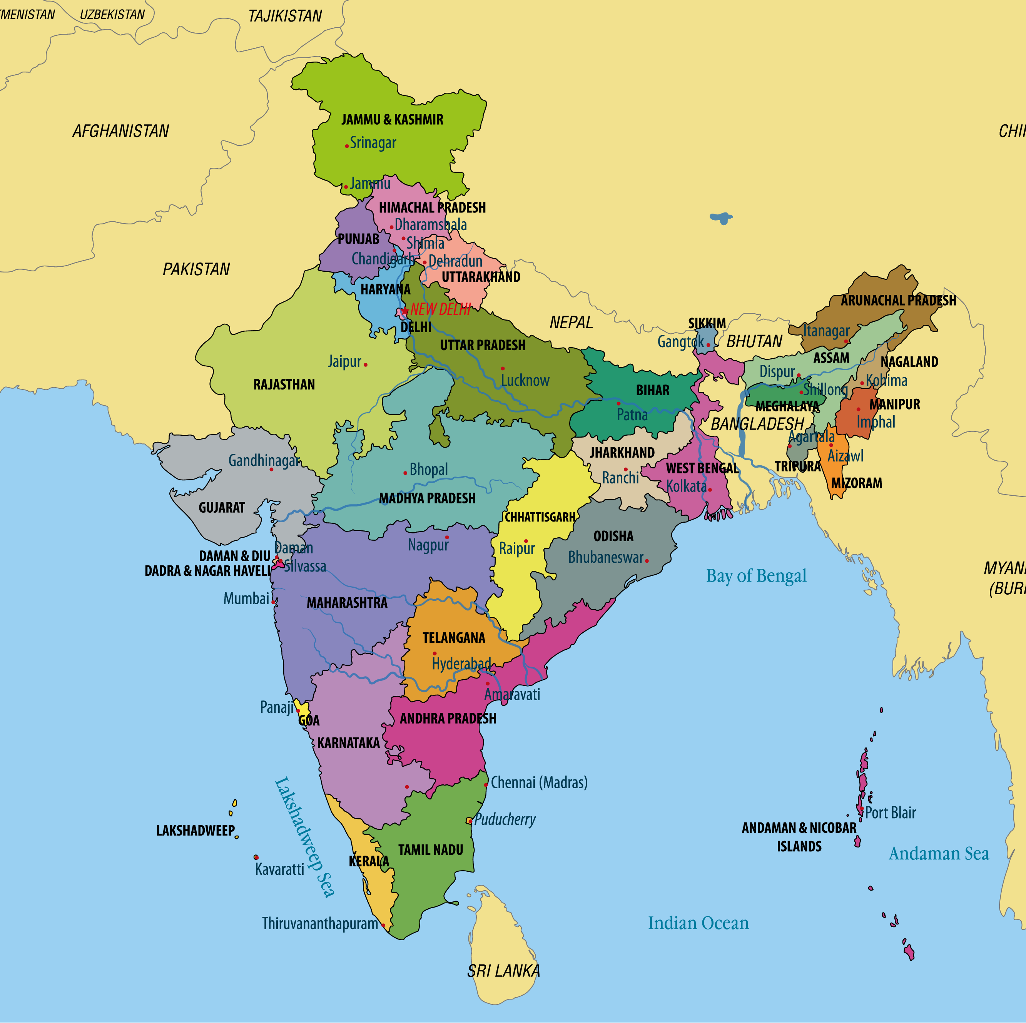
India is a large nation with a diverse landscape which makes it a great subject
1,433,448,800 people, largest population
Total land is 2,973,190Km^2
Located in South Asia. Made up of 28 states and 8 Union territories.
The capital is New Delhi

Slide 3
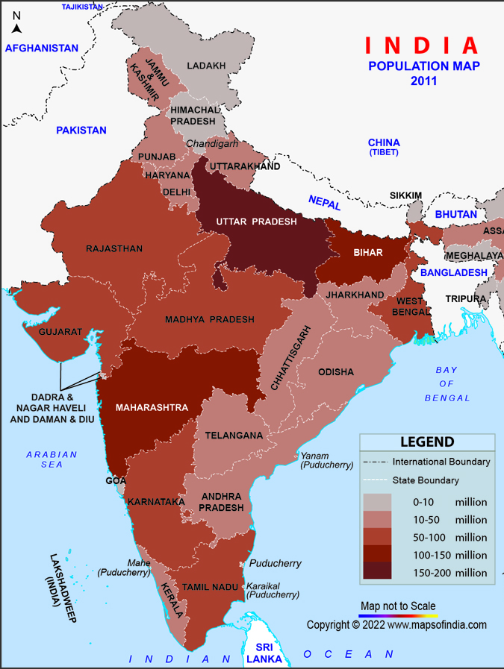
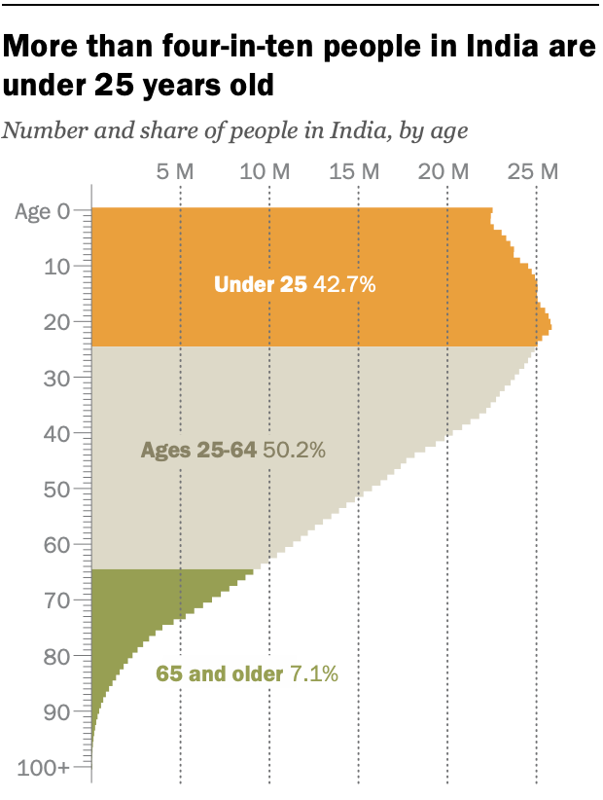
Population Distribution Urban vs rural population
Slides with informative data and maps/graphs on:
Demographics
India's population is distributed unevenly, with a significant portion residing in urban areas. The coexistence of various ethnicities, languages, and religions adds to the nation's unique demographic tapestry.

Slide 4
GDP, major industries, ecom chall and oppor
Slides with informative data and maps/graphs on:
Economics
India's economy is diverse, with major industries including information technology, agriculture, and manufacturing. However, challenges like income inequality and infrastructure gaps persist.
India has a GDP of nearly 3.7 trillion USD, ranking 5th in the world.

Slide 5
Overview of resource, challenges in resour management
Slides with informative data and maps/graphs on:
Natural Resources
India is rich in natural resources, including arable land, minerals, and renewable energy potential. Despite this, sustainable resource management remains a challenge, necessitating thoughtful strategies.

Slide 6
Tranporatioting infracturacute challenges and solutions
Slides with informative data and maps/graphs on:
Transportation
The transportation infrastructure spans a vast network of roads, railways, and air travel. As India grapples with the environmental impact, there's a growing need for sustainable transportation solutions.

Slide 7
Non-sustainable area (aspect that is unsustainable, eg pollution is major cities)
Slide(s) containing information on a non-sustainable area of the country
Pollution, particularly in major cities like Delhi, poses a significant challenge. Air and water pollution demand urgent attention to ensure a healthier future for all.

Slide 8
Sustainable practices and policies renewable energy waste management initiatives
Slide(s) containing recommendations to make this country more sustainable
Embrace renewable energy sources like solar and wind power.
Implement robust waste management systems.
Promote sustainable transportation modes.
Encourage public awareness and community engagement in environmental initiatives.

Slide 9
Summarize key findings Emphasize this for indias future
Conclusion slide(s)
In conclusion, India stands at a crossroads, facing both challenges and opportunities in its journey towards sustainability. By adopting eco-friendly practices and fostering a collective commitment to change, India can pave the way for a greener and more sustainable future.

Slide 10
https://www.mapsofindia.com/maps/india/population.htm
https://www.pewresearch.org/short-reads/2023/02/09/key-facts-as-india-surpasses-china-as-the-worlds-most-populous-country/
https://www.imf.org/external/datamapper/profile/IND
References slide: be sure to cite all necessary content (information, images, maps, etc.) in MLA format.

Slide 11
Rubric
Criteria | Inadequate | Competent | Proficient
Introduction (5 points possible) | No apparent introduction. Missing a title page and/or thesis. | May include a title page, but the thesis and topic are not clear and concise. | Includes a title page with the name of the presenter, the chosen topic is explained clearly, and the thesis is stated clearly.
Body (20 points possible) | May include no graphics or maps, less than 5 slides which contain text, and the slides include less than 4 items. | Some graphics or maps are included, maybe not directly related to the chosen topic. There are at least 5 slides present that contain text. | Includes maps/graphics/charts directly tied to chosen topic and slide, 5 or more slides containing text, and each text slide includes at least 4 items.
Conclusion/Summary (10 points possible) | No clear summary of main topics or missing a concluding slide. | A summary or concluding slide may be present, but does not present a clear and concise conclusion of the chosen topic (less than three items). | The main items of the chosen topic are summarized and the concluding comments are on one slide containing at least 3 items.
References (5 points possible) | No references present. | May include less than 3 references or the references are not listed using the correct MLA format. | Includes at least 3 references in the correct MLA format.

